Slide 1
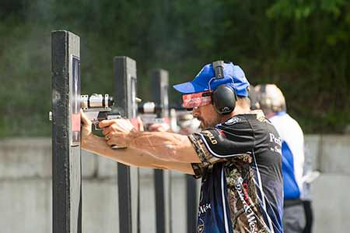
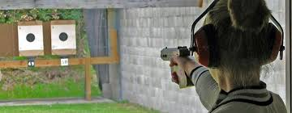
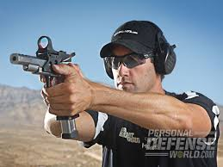
Gold Coast Pistol Club
Hazards of Lead and Shooting
And ways to Eliminate and remain safe

Slide 2
Pistol shooting and the Dangers of LEAD dust exposure
People that use firearms, handle ammunition or visit shooting ranges are at increased risk of lead exposure. Lead can enter the body through ingesting or inhaling lead particles. Once in the body, lead circulates in the blood.
When a gun fires, the primer ignites, the gunpowder lights, and some of the lead on the bullet boils. When the casing snaps out of the ejection port, lead particles trail behind it. As the bullet hurtles down the barrel of the gun, a shower of lead particles follows.
If a gun range isn't ventilated well, lead dust collects on shooters' clothing and hands and lingers in the air, where it can be inhaled. The more people shoot, the greater the risk of being exposed to dangerous amounts of lead.
In Australia, the National Health and Medical Research Council (NHMRC) recommends that if a person has a blood lead level greater than 5 µg/dL (micrograms per decilitre), the source of exposure should be investigated and reduced.
Lead exposure has adverse effects on cardiovascular health, brain function and kidney function and have been connected to blood lead levels as low as 5.
There's no amount of lead in your blood that's safe.

Slide 3
Lead exposure
Lead poisoning treatment involves both limiting your exposure to lead and reducing the amount in your blood. Without treatment, exposure to lead can lead to severe and sometimes irreversible medical problems.
Once lead gets into the body, it gets deposited in bones, making it extremely difficult to remove. If lead levels in the blood are high, steps may be taken to prevent further exposure. If the levels are high enough to pose serious harm, a process known as chelation therapy can help clear the metal from the body
Chelation therapy is a treatment that uses drugs that remove toxic metals from the body. The drugs work by binding (chelating) to metals in the blood and removing them from the body in urine or stool.

Slide 4
Lead Safety
The GCPC is an outdoor range and is well ventilated, however when you attend this range (or any other) to shoot you are exposed to lead dust.
Copper wash/coated projectiles further reduce the potential of Lead dust exposure – a large number of our shooters use these, so please consider them for your use.
Use fans to assist in creating positive air flow to eliminate Lead dust inhalation.
To eliminate or reduce the exposure risks to yourself and others, even at home follow these rules:
At the Range:
Wash your hands and forearms (and face) after shooting at the sink area on the range before entering the club house, and most importantly before eating or drinking or smoking
Ensure others do the same
Don’t disturb the lead or soil at the butts at the range ends – stay clear
If performing tasks at the butts, and there is wind disturbing the dust – DO NOT START the task.
If you must work in the location wear a P2 mask and suitable PPE

Slide 5
Lead Safety
Lead Safety at Home:
When returning from the range it is important that you remember that the clothes and footwear you have worn has been exposed to lead dust.
Remove your footwear before entering the home, and wash them down and store separately
Wash your clothes separately to the family washing
Shower and wash your hair properly
Speak to your family about lead dust so they understand
When cleaning your firearms the same safety practices should be maintained – discard the cloths used, do the task in well ventilated air spaces, and wash up afterwards

Slide 6
Lead strategies
Dietary Strategies
Certain nutrients like iron have been shown to help protect the body against lead by binding with the metal and preventing its absorption.
By contrast, iron deficiency can make it easier for the body to absorb lead
Eating foods that are rich in iron help lower the accumulation of lead in the body, this is especially true in younger children who tend to absorb lead more quickly than older kids and adults
Foods rich in iron include:
Lean meat, Seafood, Nuts, Beans, Vegetables, Fortified bread, Fortified cereals. Fortified foods contain added vitamins and minerals that aren't naturally present in them. Fortification is meant to improve people's levels of particular nutrients and is common for foods that adults and children typically eat, such as grains, milk, and juice.
Vitamin C can also play a role by helping the body absorb more iron. Calcium found in dairy products and dark green vegetables can make it harder for lead to accumulate in bones.
Vitamin or mineral supplements thought to reduce lead absorption or accumulation include: Vitamin C, Calcium, Iron, Zinc, Phosphorus.
The supplements thought to increase the excretion of lead from the body include: Vitamin C, Iron, Vitamin B1, Vitamin E

Slide 7
Conclusion
Pistol shooting is a safe and enjoyable family sport, but as like mnany activities comes with certain risks.
Remember to Avoid the areas where lead exists (the Butts) and remain clear
Wash your hands and forearms and face with soap and water after shooting and PARTICULARLY before eating and drinking
Don’t enter your home in your shooting footware
Wash your clothes separately
Shower and wash your hair as soon as possible after arriving home
Talk to the family about Lead safety

